Slide 2
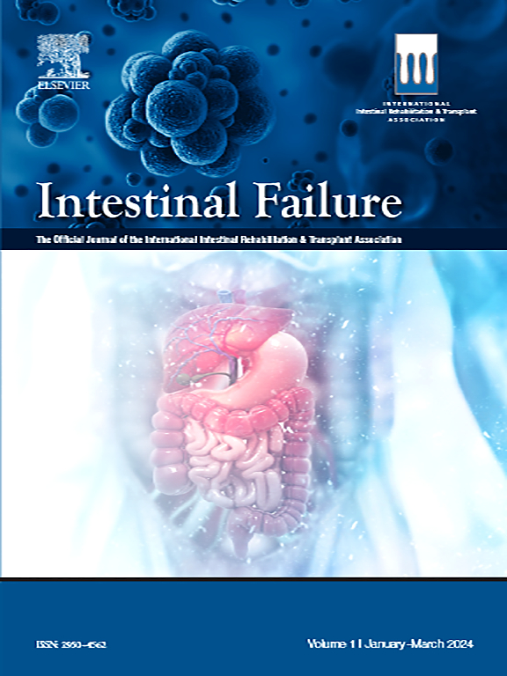
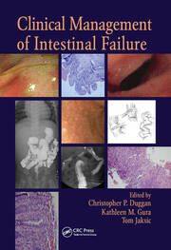
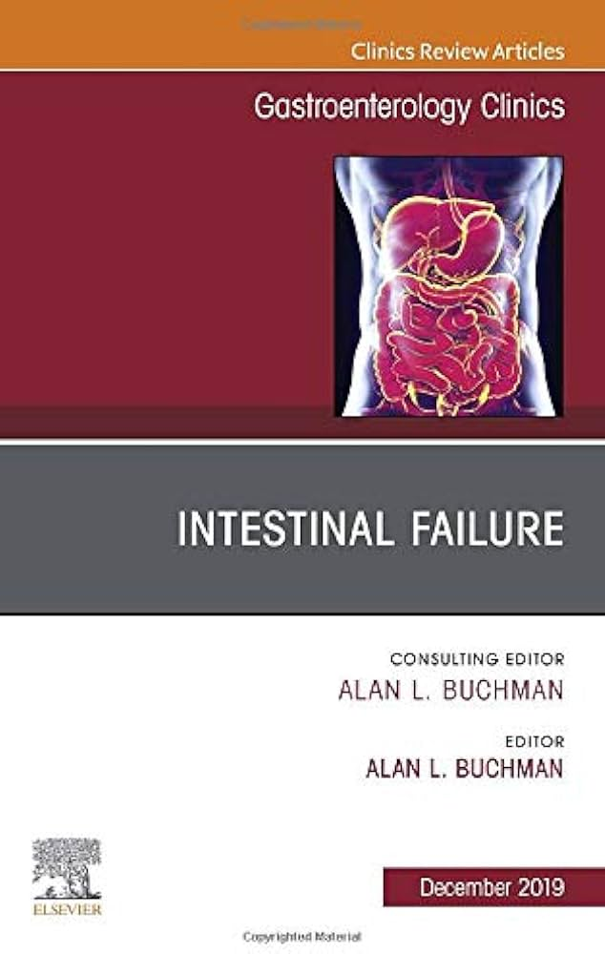
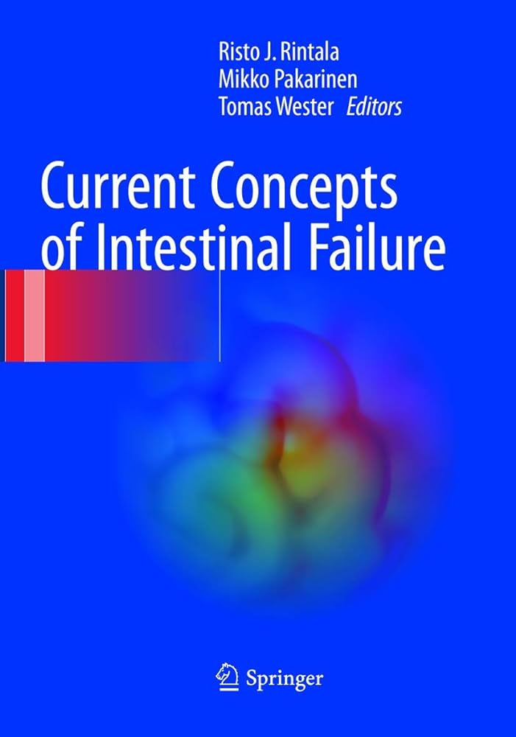
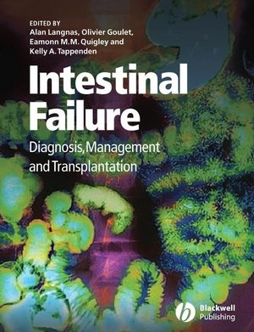
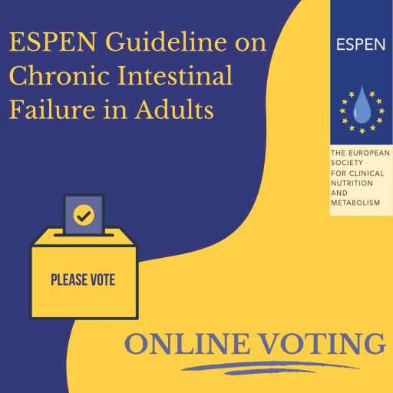

Slide 3
Agenda
Introduction.
Definition.
Aetiology.
Classification.
Intestinal rehabilitation.
Management.
Home message.

Slide 4
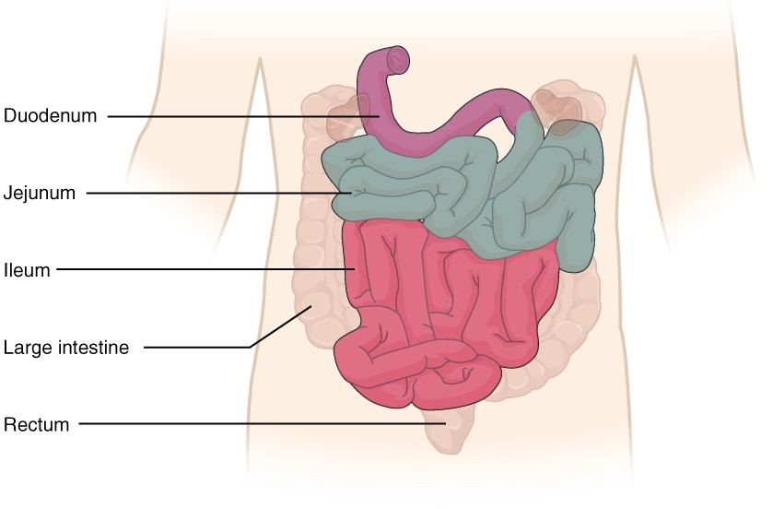
Introduction for normal intestine

Slide 5
Intestinal Failure_(IF)
Definition:
Intestinal failure (IF) is defined as “reduction of gut function below the minimum necessary for the absorption of macronutrients and/or water and electrolytes, such that intravenous supplementation is required to maintain health and/or growth.”
Short bowel syndrome (SBS) is defined as a chronic malabsorptive condition caused by anatomic reduction of small bowel length (typically <200 cm remaining).
(IF ) is the latest terminology to describe clinical features and functional status; it is more descriptive than SBS, an anatomic definition only.
IF = intestinal failure
SBS = Short bowel syndrome
Pironi L et al., Definition and classification of intestinal failure inadults. Clin Nutr ;34:171–180.(2018).

Slide 6
SBS is one of many etiologies for( IF). There are 5 major pathophysiologic mechanisms for (IF):
(1) SBS.
(2) extensive mucosal disease.
(3) mechanical obstruction.
(4) dysmotility.
(5) fistula.
SBS is the most common etiology accounting for 64.3% of( IF )cases in adults by a recent multinational estimate; second is dysmotility.
(IF) is the extreme of the continuum from intestinal sufficiency to insufficiency to failure and consequently requires parenteral support (PS).
Pironi L et al., Definition and classification of intestinal failure inadults. Clin Nutr ;34:171–180.(2018).

Slide 7
Insufficiency refers to reduction in absorptive function without need for (PS).
The small intestine is the most rare organ to fail; point prevalence for (IF) in Europe based on home( PS) data is estimated anywhere from 5–20 patients per million.
Pironi L et al., Definition and classification of intestinal failure inadults. Clin Nutr ;34:171–180.(2018).

Slide 8
Etiology for Intestinal Failure
Short bowel | Extensive mucosal disease | Mechanical obstruction | Dysmotility | Fistula
Serial or massive small bowel resection for: •Crohn’s disease •Malignancy or benign tumor •Mesenteric vascular insufficiency or ischemia (superior mesenteric artery embolism or thrombosis, superior mesenteric vein thrombosis) •Radiation enteritis •Familial polyposis •Trauma (motor vehicle accidents, gunshot wounds) | •Crohn’s disease •Refractory sprue •Celiac disease Autoimmune enteropathy •Common variable immunodeficiency •Intestinal lymphangiectasia •Chemotherapy-related enteritis •Radiation enteritis •Other enteropathies | •Intrinsic bowel lesions: strictures or stenosis (IBD, anastomotic, neoplastic, chemical) •Obturation: adhesions, feces, foreign bodies, tumors, gallstones | Chronic intestinal pseudo-obstruction: •Primary (idiopathic) •Secondary: collagen vascular diseases (scleroderma, mixed connective tissue disease), medication associated, paraneoplastic, neurologic (Alzheimer, Chagas, Parkinson), endocrine diseases | •Iatrogenic (postoperation) •Inflammatory (Crohn’s, diverticular) •Neoplastic (colon cancer, small bowel malignancy) •Infectious (TB) •Trauma •Foreign body
IBD, inflammatory bowel disease; TB, tuberculosis.

Slide 9
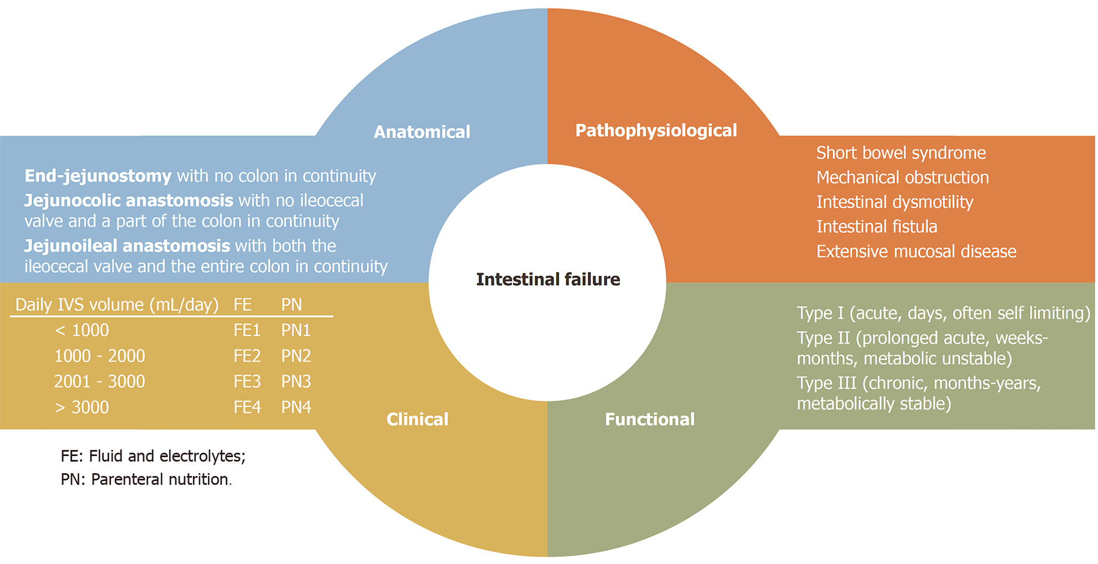
Classification

Slide 10
Classification
Once( IF )is determined, it can be classified according to functional, pathophysiological ,anatomical and clinical criteria.
The functional classification is based on onset and expected outcomes for patients.
Type I is acute in its development, short-term in duration, and typically self-limited seen in relation with critical illness and the perioperative setting.
Type II is subacute in its development, more prolonged in its course, and requires weeks to months of PS; it is uncommon and follows an acute abdominal event necessitating surgery.
Type III is chronic, requires home PS for months to years, and may or may not be reversible.
Pironi L et al., Clinical classification of adult patients with chronic intestinal failure due to benign disease: aninternational multicenter cross-sectional survey. Clin Nutr ;37:728–738.(2018).

Slide 11
Pathophysiological classification divides etiologies based on mechanisms of 5 major :
(SBS) reduced absorptive surface .
(mucosal disease or enteropathy) inefficient absorptive surface.
(mechanical obstruction) fasting for bowel rest.
(dysmotility) restricted intake to avoid exacerbation of digestive symptoms.
(fistula) bypassing absorptive surface.
Various diseases can overlap categories giving rise to (IF) through multiple routes.
Crohn’s disease is the most common etiology (22.4%) underlying (IF) cases.
Pironi L et al., Clinical classification of adult patients with chronic intestinal failure due to benign disease: aninternational multicenter cross-sectional survey. Clin Nutr ;37:728–738.(2018).

Slide 12
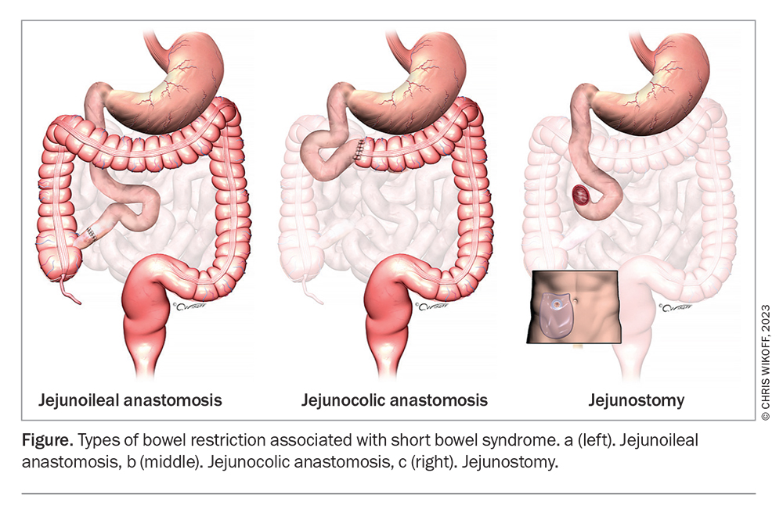
SBS can be subdivided based on anatomy: jejunoileocolonic anastomosis, jejunocolonic anastomosis, and end jejunostomy or ileostomy. These classifications have clinical implications in terms of patient outcomes and ability to rehabilitate IF.
Pironi L et al., Clinical classification of adult patients with chronic intestinal failure due to benign disease: aninternational multicenter cross-sectional survey. Clin Nutr ;37:728–738.(2018).

Slide 13
Intestinal Rehabilitation
Some( IF) patients initially requiring( PS) can be weaned from intravenous nutrition therapy,this success is partially caused by physiologic adaptation of the intestine. After resection, a natural compensatory process occurs that includes:
Villous hypertrophy
Dilation
Elongation resulting in increased villus height and diameter
Greater crypt depth
Increasing intestinal blood flow
upregulation of transporters (sodium-glucose).
Jeppesen PB et al ., Fuglsang KA. Nutritional therapy in adult short bowel syndrome patients with chronic intestinal failure. Gas_x0002_troenterol Clin North Am 2018;47:61–75.(2018).

Slide 14
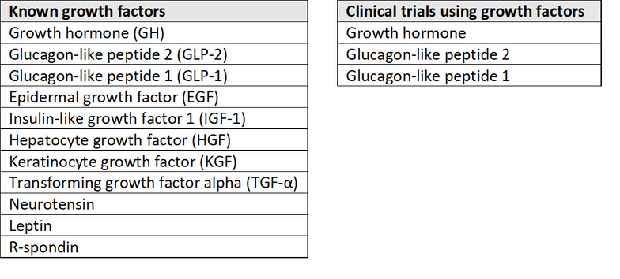
What are intestinal growth factors?
The intestinal growth factors are a group of hormones that stimulate some form of growth within the bowel.
It means that the villi (tiny projections on the inside of the bowel) become longer and therefore the surface area increases.
Schwartz LK et al., Long-term teduglutide for the treatment of patients with intestinal failure associated with short bowel syndrome. Clin Transl Gastroenterol;7:e142.(2018).

Slide 15
How do they work?
Apart from growth hormone, the growth factors are specific proteins produced from the bowel but act on a different parts of the bowel.
The growth factor which has the most effect on intestinal growth is called glucagon-like peptide 2 (GLP 2).
GLP 2 is produced in the lower part of the small bowel (ileum) by enteroendocrine L cells.
When food gets to that part of the bowel then GLP 2 released into the blood stream, GLP 2 then acts on the small bowel causing the villi to become longer and that way the surface area of the small bowel increases, allowing more fluid and nutrition to be absorbed.
It also increases the blood flow to the bowel and to the liver, can improve liver function, and can help bone strength to improve.

Slide 16
GLP 2 is a fragile protein, which degrades in the body within minutes.
by making small changes can be made to the GLP 2 protein, it is not broken down so quickly and therefore can be given as a once-a-day injection, (called GLP 2 analogues)
there is only one licensed medication called teduglutide (Gattex®, Revestive®). Other products will be available in time.

Slide 17
Who could this be helpful for?
This treatment can be considered in patients who have “short bowel syndrome” and are dependent on parenteral nutrition or parenteral fluid support.
Patients who have had a large amount of their small bowel removed have generally had the lower part of their small bowel removed.Therefore, giving medication that reproduces the GLP 2 hormone can be very effective.
Patients who have their colon joined to their remaining small bowel also respond to this treatment.

Slide 18
Who is this not helpful for?
This sort of treatment is not helpful for patients with intestinal failure, requiring intravenous nutrition or fluid support, but who do not have a short bowel.
Also, patients who have obstructive symptoms (nausea and vomiting with abdominal pain) may get worse with this type of treatment.

Slide 19
What are the benefits?

Slide 20
What are the side-effects?
Common side effects, occurring in over 10% patients include:
Abdominal pain
Nausea
Vomiting
Swelling of the hands or feet
Cold or flu symptoms
Allergic reactions
Skin reactions where the injection was given
N.B.
In addition, patients who have had a cancer within the last 5 years should avoid taking anything considered to be a growth factor. Patients who have a residual large bowel (colon) need to have regular surveillance to see if they form any polyps or early cancers.

Slide 21
In England & Wales, the National Institute of Clinical Excellent (NICE) approved teduglutide (Revestive®) in June 2022. It should start to be available for the treatment of patients aged 1 year and above with short bowel syndrome (SBS) from around October 2022.
In Scotland, the Scottish Medicines Consortium approved teduglutide in the context of an approved NHS Scotland Patient Access Scheme arrangement for children in April 2018 and in adults in February 2020.

Slide 22
Factors suggesting inability to wean from parenteral support (mainly in SBS)
•Length <35 cm if jejunoileal anastomosis and colon in continuity•Length <60 cm if jejunocolic anastomosis with no ileum remaining but colon in continuity•Length <115 cm if end jejunostomy with no ileum and only portion of jejunum remaining•Mucosal disease in residual small bowel•Absence of a colon•Absence of ileum/IC valve•End jejunostomy•Poor nutritional status•Duration of time on parenteral nutrition >2 years•Fasting plasma citrulline <15 μmol/L
•
Length <35 cm if jejunoileal anastomosis and colon in continuity
Length <60 cm if jejunocolic anastomosis with no ileum remaining but colon in continuity
Length <115 cm if end jejunostomy with no ileum and only portion of jejunum remaining
Mucosal disease in residual small bowel•
Absence of a colon•
Absence of ileum/IC valve•
End jejunostomy•
Poor nutritional status•
Duration of time on parenteral nutrition >2 years•
Fasting plasma citrulline <15 μmol/L
Factors suggesting inability to wean from parenteral support (mainly in SBS)

Slide 23
Medical Management
The goal of medical management is to optimize nutrition whether oral, enteral, or parenteral;minimize symptoms and manage PS including weaning if able.
( IF) patients are a heterogenous group and dietary recommendations require individualization.
For those with SBS best-practice eating advice may include ingesting a complex carbohydrate, protein, and fat at each meal; restricting simple sugars; distributing food throughout the day; restricting fluid intake with meals; and choosing hypo-osmolar or isotonic fluids.
For those on PS, calorie goal is typically 25–30 kcal/kg/day and protein 1.2–2.0 g/kg/day.
Urine output, serum electrolytes, and vitamin/mineral levels require monitoring and correcting.
Jeppesen PB et al ., Fuglsang KA. Nutritional therapy in adult short bowel syndrome patients with chronic intestinal failure. Gas_x0002_troenterol Clin North Am 2018;47:61–75.(2018).

Slide 24
Some medications reduce severity of (IF) symptoms, such as H2 blockers or proton pump inhibitors to reduce gastric secretions and suppress acid.
Antidiarrheals, such as loperamide, codeine, diphenoxylate/atropine, tincture of opium, and clonidine, are used to slow intestinal motility.
Octreotide, glutamine, and growth hormone were previously used to slow transit and for trophic effects, respectively, but have fallen out of favor because of detrimental effect on splanchnic protein synthesis, thus inhibiting intestinal adaptation and conflicting results regarding efficacy.
One gastrointestinal hormone that aims to maximize absorption, decrease fluid losses, and reduce PS needs has proven useful. Teduglutide is a synthetic GLP-2 analogue administered as a subcutaneous injection dosed at 0.05 mg/kg daily and approved for use in SBS.

Slide 25
Surgical Management
The goal of surgical management is to preserve bowel and maximize remaining function.
Examples are performing reanastomosis of remaining small bowel to residual colon, repairing fistulas, relieving small bowel obstructions, and eliminating diseased bowel. Autologous gastrointestinal reconstructive surgery is an alternative management option.
Intestinal transplant (isolated or with liver) is a consideration for patients on lifelong PS with related complications.
Transplantion survival has improved over time because of improved surgical techniques and optimization of immunosuppressive regimens.
Survival rates were 77% at 1 year, 58% at 5 years, and 47% at 10 years with 67% of transplant recipients off PS entirely.

Slide 26
Take-Home Messages for Gastroenterologists
(IF) is defined as “reduction of gut function below the minimum necessary for the absorption of macronutrients and/or water and electrolytes, such that intravenous supplementation is required to maintain health and/or growth.”
(IF) can result from a variety of etiologies including SBS.
An individualized approach for management of (IF )is essential based on patient’s anatomy and underlying disease state. Prognosis is driven by type and extent of resection, if present, along with underlying disease.
The GLP-2 analogue teduglutide has been successful in reducing PS needs.
Intestinal transplant is an option for (IF) refractory to medical therapy for those on lifelong PS and experiencing complications.

